Slide 1










Real Or Fake Job Posting
Team Members:
Liangrui Lu
Yijie Fan
Ziyi Li
Jiashu Wang
Yingnan Mu

Slide 2



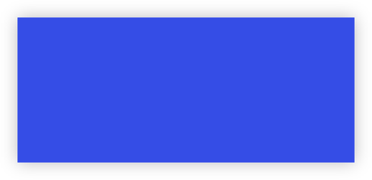


Agenda
01
02
Introduction & Background
Data Collection & Cleaning
03
04
Models
Result & Recommandations

Slide 3



01
Introduction
Background

Slide 4

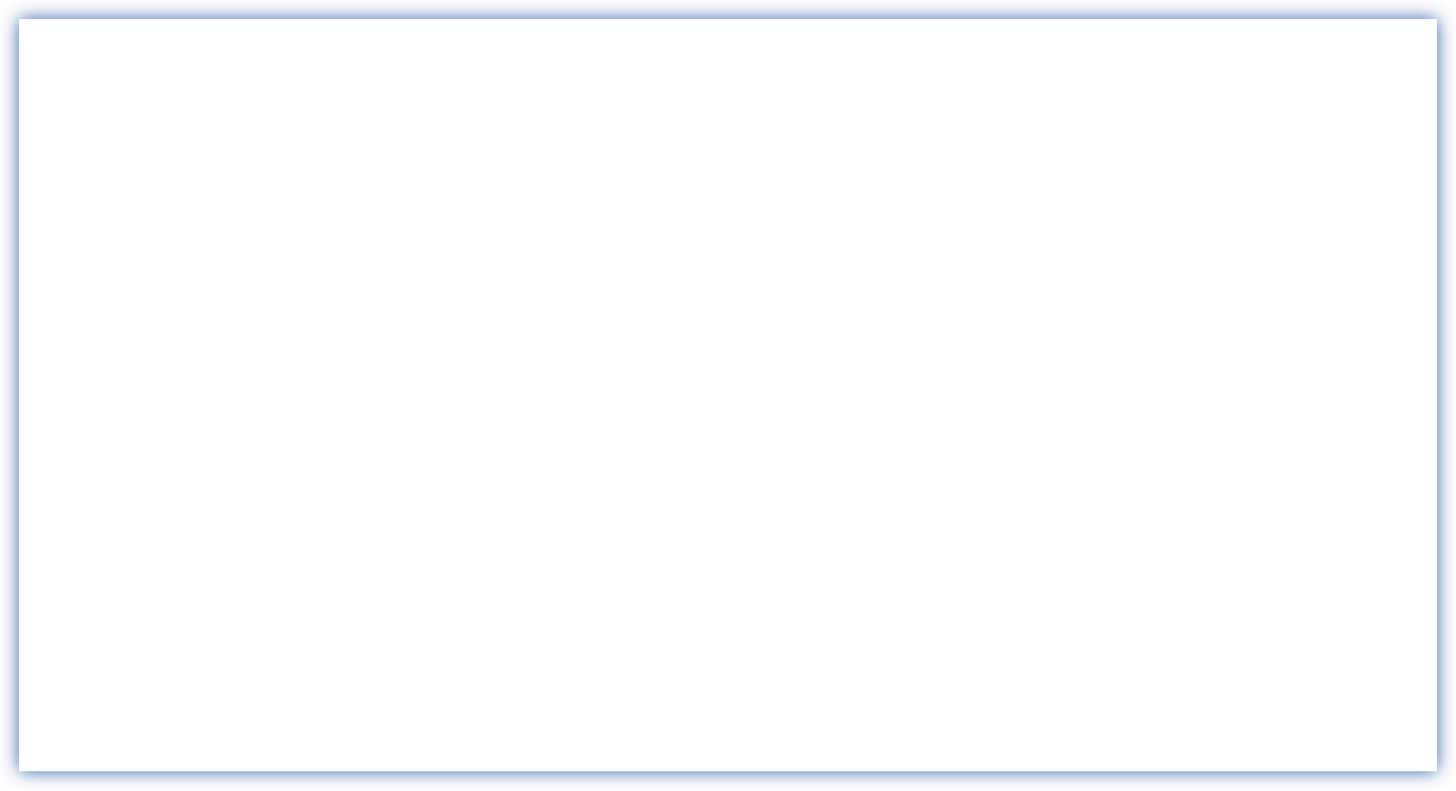


Project Introduction
Background
Topic
What is the most important factor in a company? Nowadays, we believe manpower is the key in the future. Company who has the best cruw will lead the future in their society. Company provided various compensation plans to attract future canadians. People have the ability to choose what they want. Our team picked this topic because we think it is very valuable for a company. We will determine whether an job posting is real or not. From exploratory data analysis, we were encouraged to implement various machine learning models and compare their results. This professional dataset that we found from Kaggle.

Slide 5








Project Workflow
Background
Data Cleaning
Models
Result
1
2
3
4
5
6
Naive Bayes
Random Forest
Association Rule
K-Nearest-Neighbor
Classification Tree
Bi-LSTM NN

Slide 6


Project Introduction
Research Question
2. How can we determine the fake job posting?
3. How could we do classification with the help of text mining?
1. What kind of information would job posting give?
4. How can we combine different methods to get a robust predictive model?

Slide 7

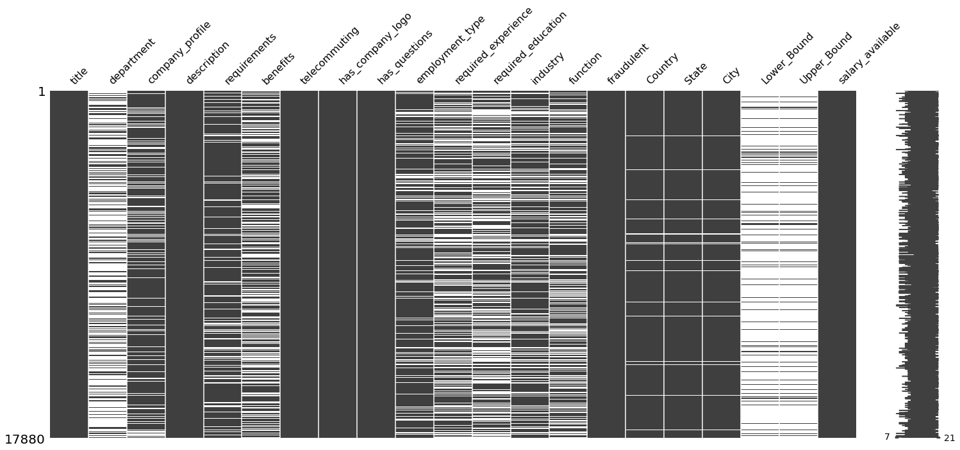


Data Preparation
Plot from python
Data plot
From the this graph, it’s clear that our dataset contains lots of missing data, which should also be regarded as factors, since fake jobs tend to leave more columns blank.
Tools
1

Slide 8






Project Introduction
Data Cleaning
Include
Python
Fill missing values
Extract column information: salary_range
Numerical variables normalization
Mapping dummies to words
Encoding categorical data to indexes
Concatenate all texts
Python

Slide 9
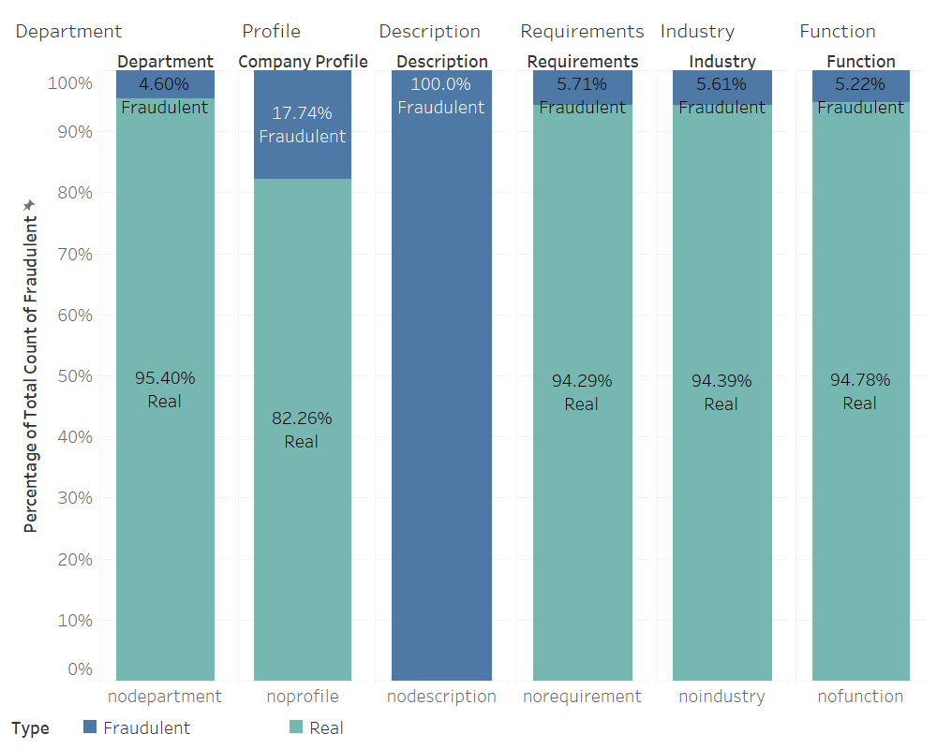
Exploratory Analysis
At first, we have done some exploratory Analysis. We focus on the fraudulent rate in each variable.

Slide 10
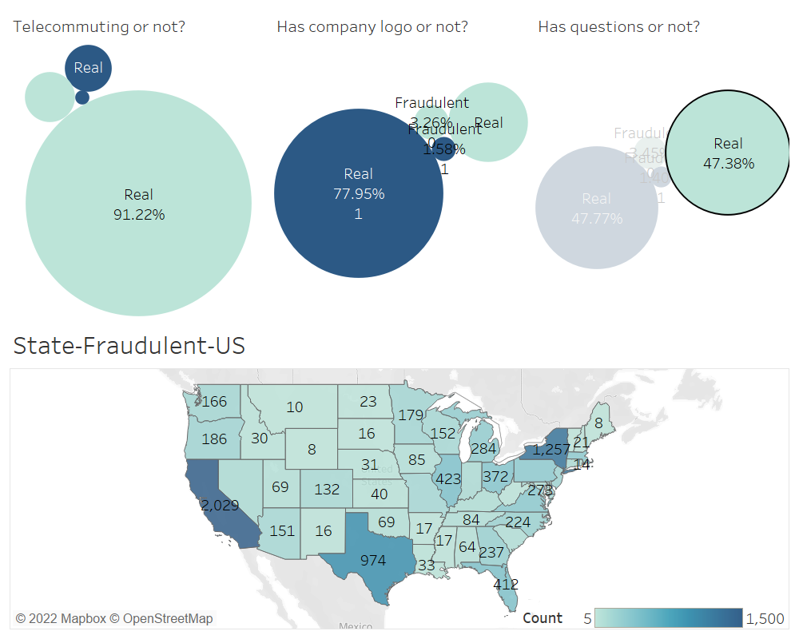
Exploratory Analysis
More exploratory analysis?

Slide 11
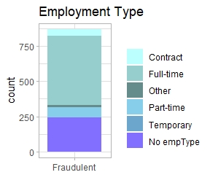
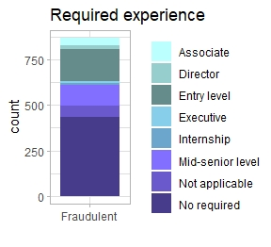
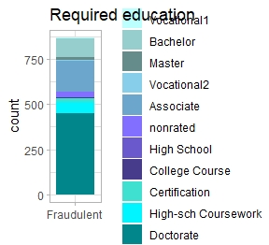
Exploratory Analysis

Slide 12
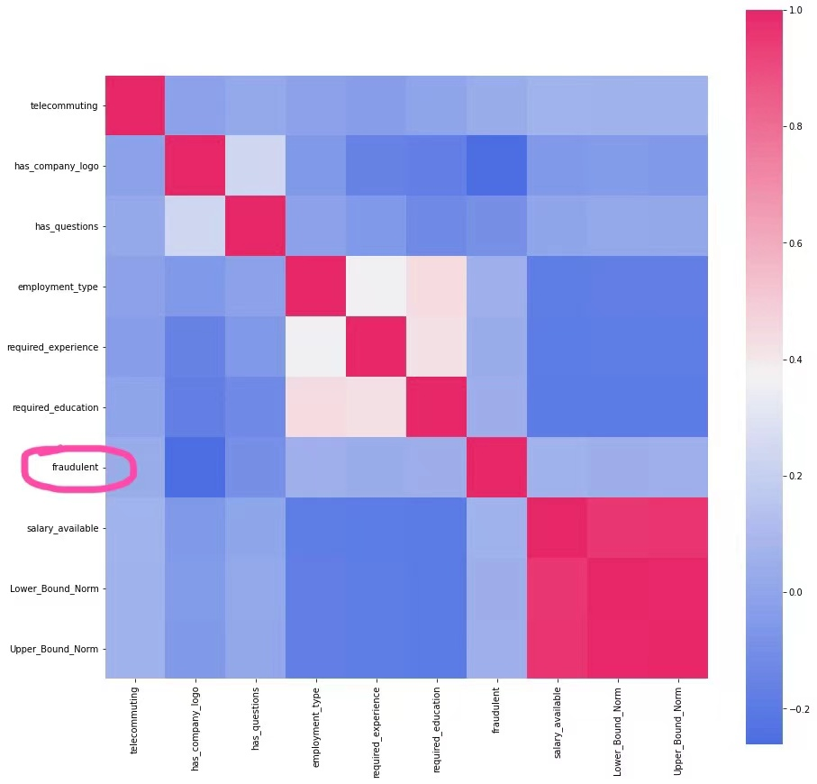





Data Preparation
Plot from python
1
Data plot
2
Tools
From the heatmap, we are able to claim that there are no clear relationship between fraudulent and any numerical or categorical data; nevertheless, some categorical variables, like has_company_logo, are related to fraudulent
3
4

Slide 13
02
Model
Different Models

Slide 14


Models
It's A New Attempt!
Naive Bayes
Random Forest
Association Rules
KNN
Classification Tree
Text Mining

Slide 15




Models
Random Forest
Ensemble method: improving prediction accuracy
KNN
Classify a new document by its K nearest neighbors
Greater distance indicates dissimilarity between documents
Smaller distance indicates co-occurrence of words in documents.

Slide 16

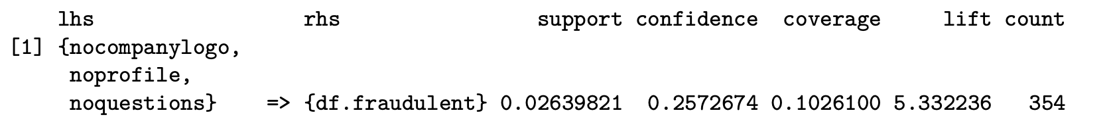
Models
Association rule
Identify which words always occur together with “fraudulent”.
Choose the rule with the highest lift
Classify the documents which include “nocompanylogo,noprofile,noquestions” as “fraudulent”

Slide 17
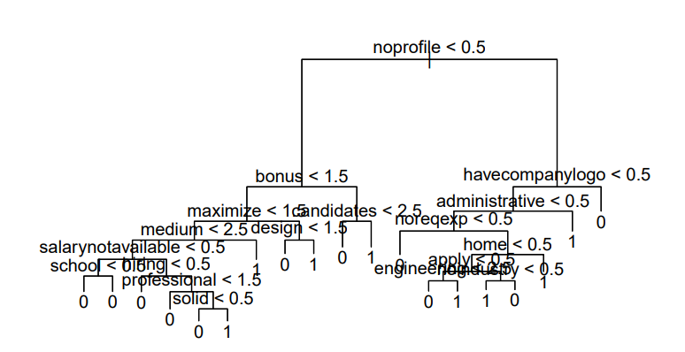

Models
Classification Tree
Words are regarded as predictors to classify a new document as “real” or “fake”

Slide 18
Performance Measures of Models
Naive Bayes | 0.8400 | 0.8539 | 0.8393
Random Forest | 0.9801 | 0.5936 | 1
Association Rule | 0.9125 | 0.5799 | 0.9297
KNN | 0.9671 | 0.7626 | 0.9777
Classification Tree | 0.9687 | 0.5571 | 0.9899

Slide 19
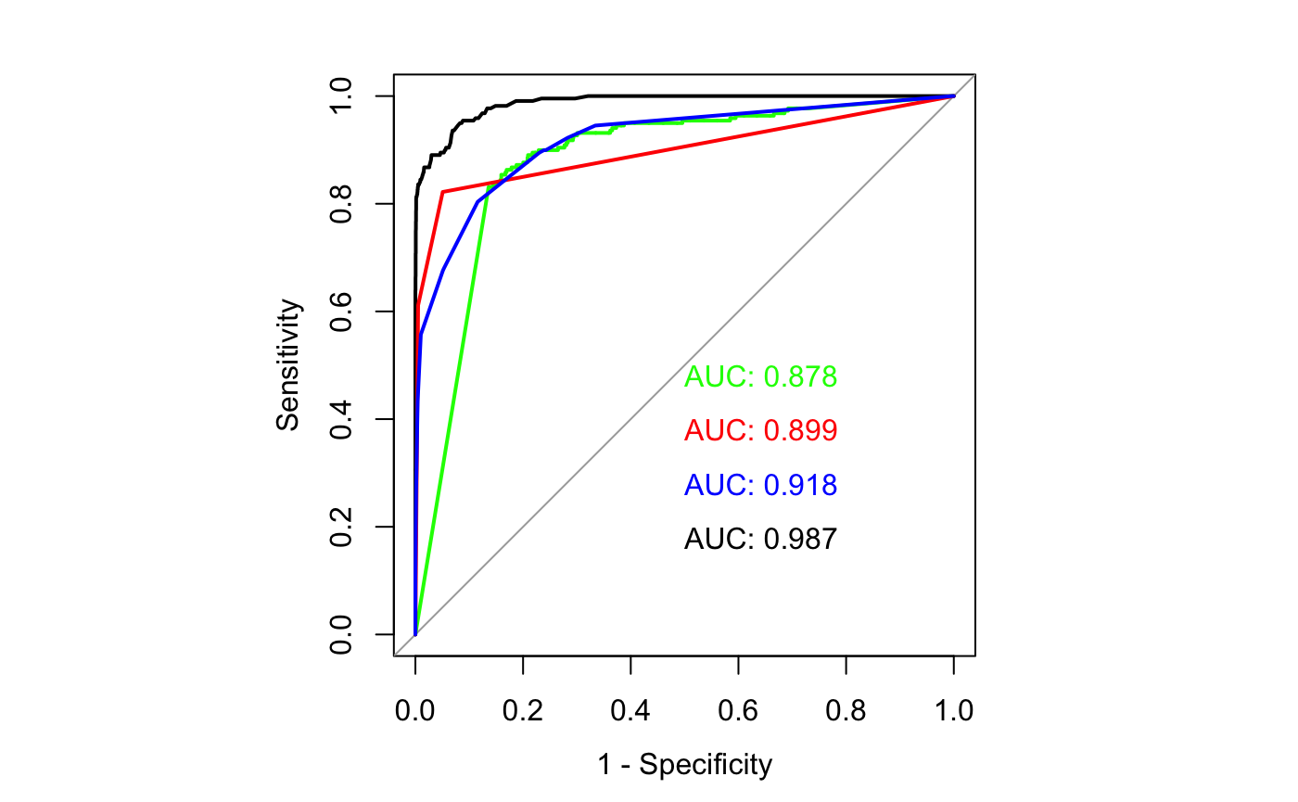

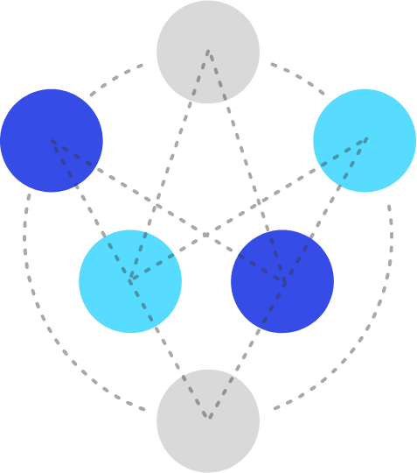






Performance Measures of Models
Green line: Naive Bayes
Red line: KNN
Blue line: Classification Tree
Black line: Random Forest
1
2

Slide 20
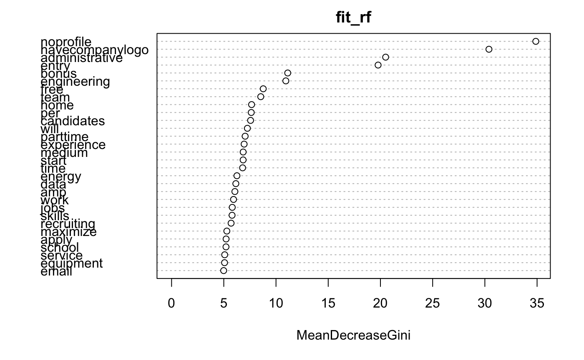
Outlook
We can select features from the importance chart of Random Forest Model.
Simply speaking, the Gini Index is measure of purity of each node. This chart tell us which keywords should be considered to do the improve the accuracy of classification.

Slide 21
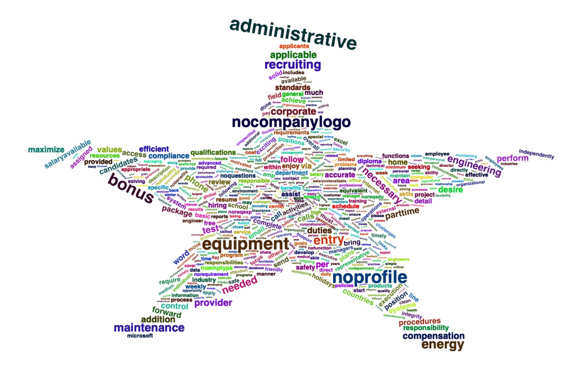
Outlook
We can also select features by using the word cloud method.
We import a ratio to measure the frequency of each word present in the fake job or real job description. Sort the value in descending way, we can find a fake job often accompanied by words like “administrative” or “nocompanylogo”.

Slide 22
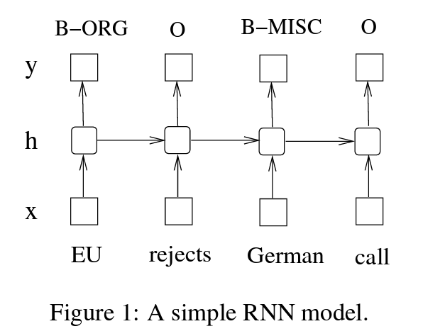
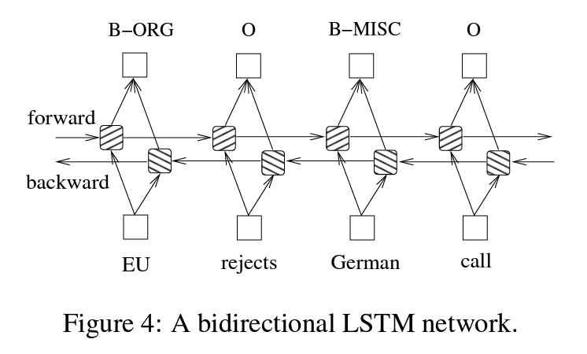
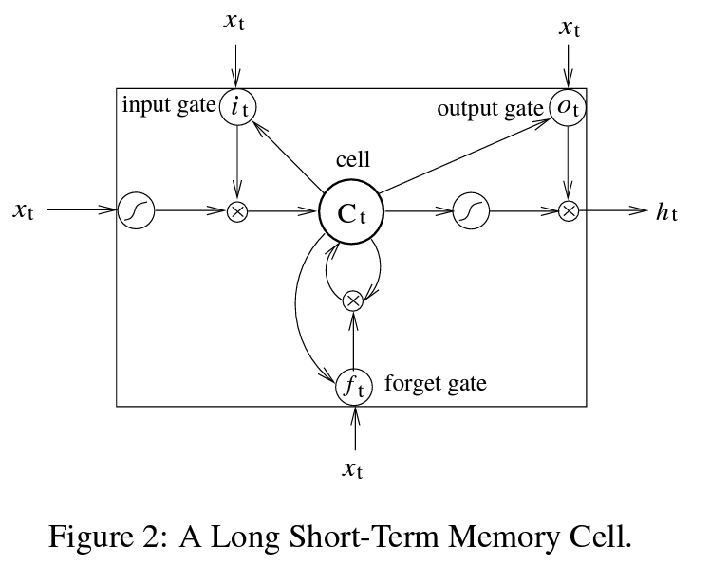
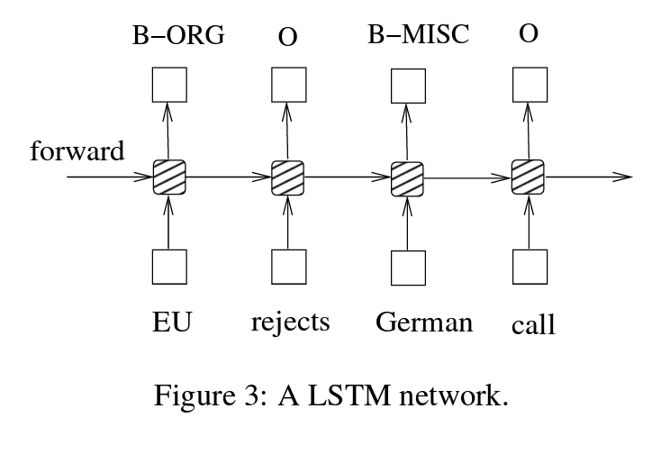
NLP Neural Network Model

Slide 23

Models
Bi-LSTM Model
BI-LSTM
NLP Neural Network Model
Process:
Text cleaning: make text lowercase, remove special characters, links, remove punctuation and remove words containing numbers.
Remove stop words.
Lemmatize, which is also known as stemming, that is changing words to it’s root.
Tokenize text to sequences.

Slide 24
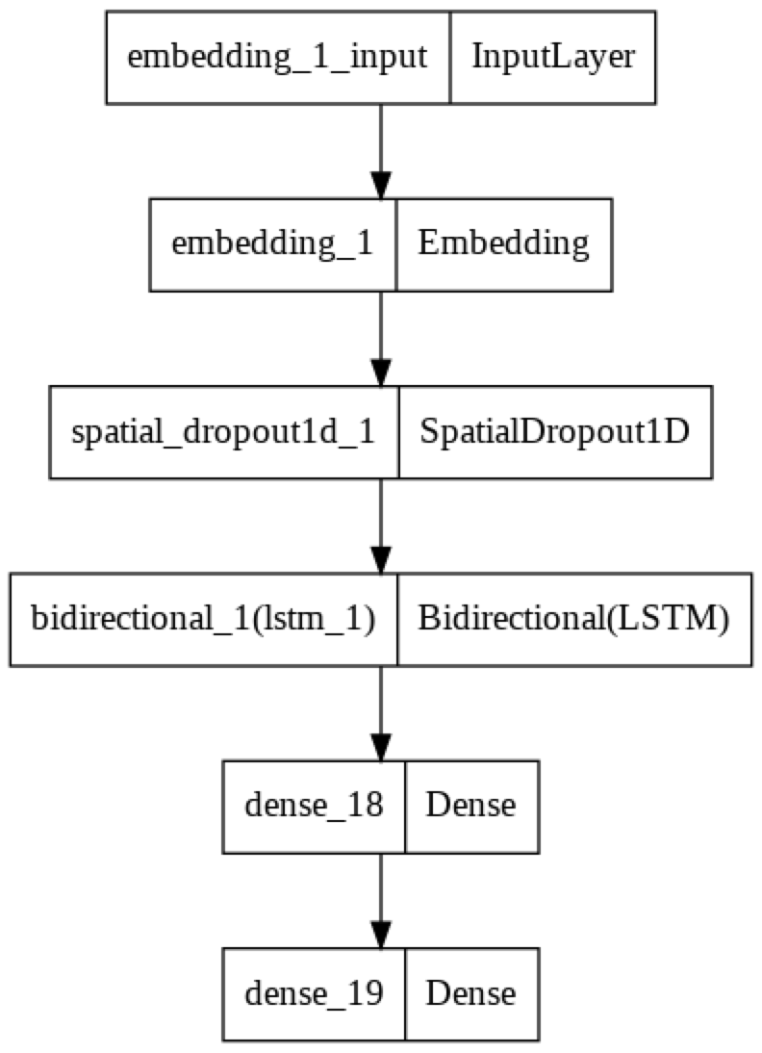
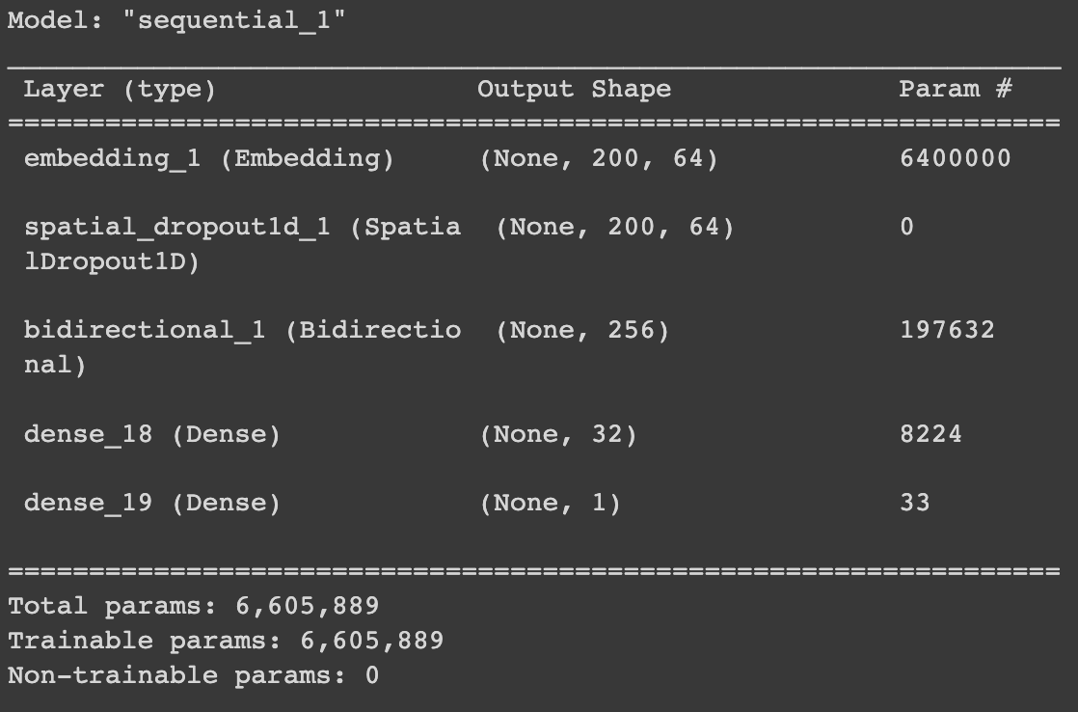
Models
NLP Network Model
BI-LSTM
Business

Slide 25
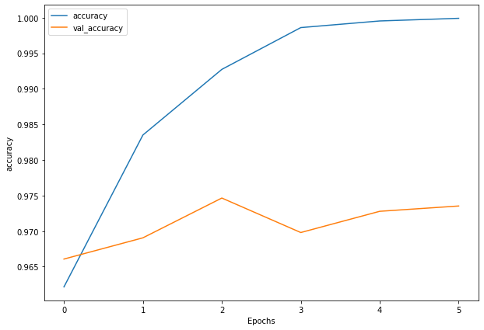
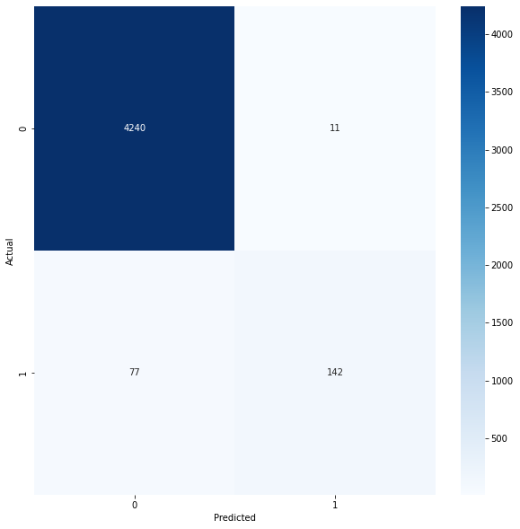
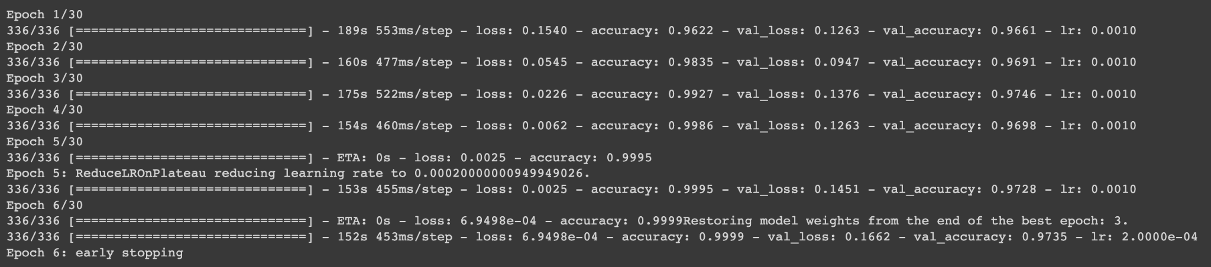
Models
Bi-LSTM Model

Slide 26
03
Best Models

Slide 27
Pick Best Models
How to determine the best?
1
2
3

Slide 28
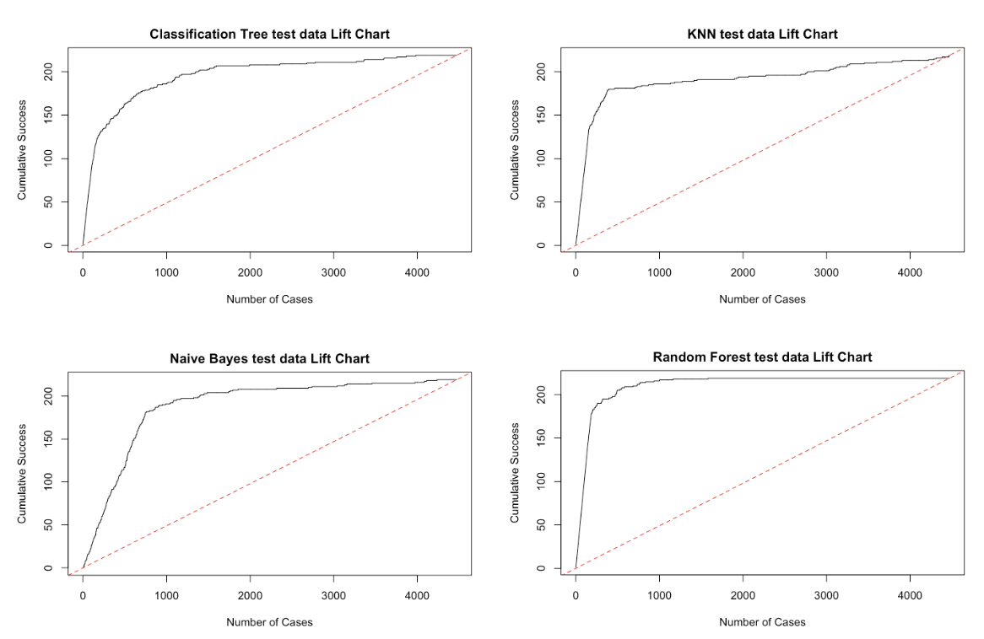
Lift Chart

Slide 29
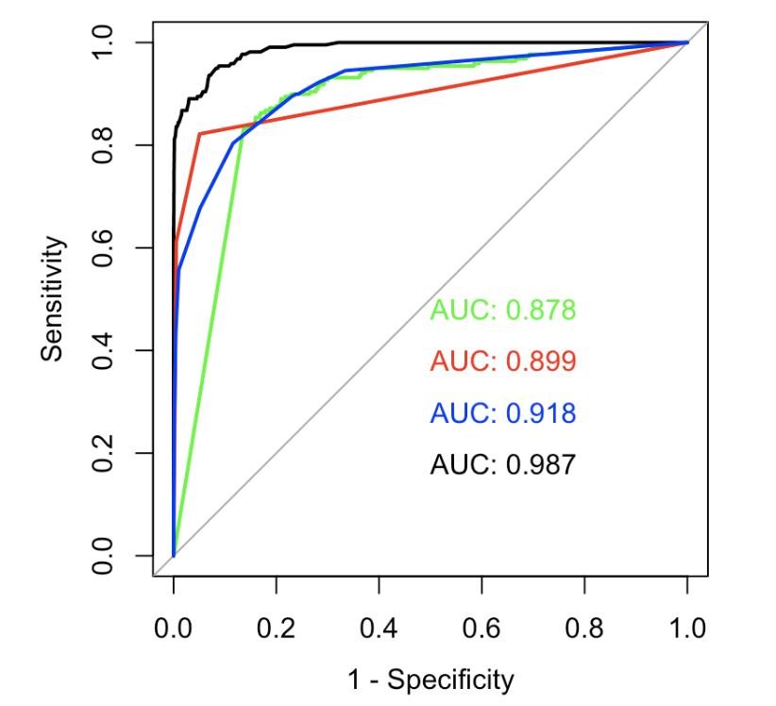
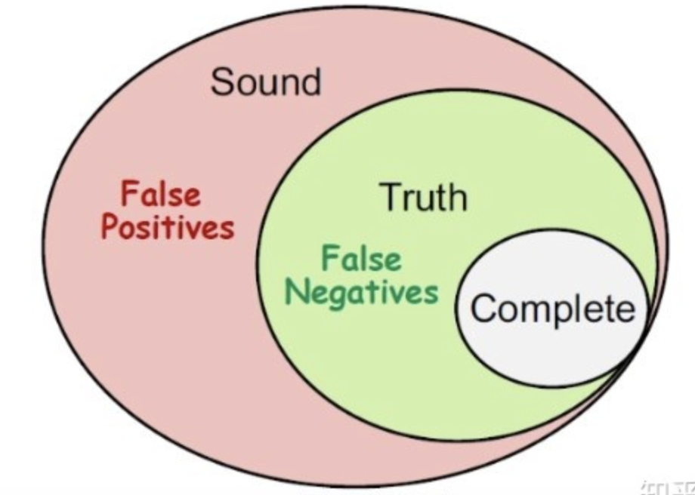
Project prospects
Results
AUC
Soundness& Completeness

Slide 30
04
Votes

Slide 31
Project prospects
Results
Model | Accuracy | Sensitivity | Specificity
Naive Bayes | 0.8400 | 0.8539 | 0.8393
Random Forest | 0.9801 | 0.5936 | 1
Association Rule | 0.9125 | 0.5799 | 0.9297
KNN | 0.9671 | 0.7626 | 0.9777
Classification Tree | 0.9687 | 0.5571 | 0.9899
Bi-LSTM | 0.9803 | 0.6484 | 0.9974
Most Sound!
Totally Complete!
Most Accurate!

Slide 32
Project prospects
Results
Model | Accuracy | Sensitivity | Specificity
Vote by NB, RF, Bi_LSTM | 0.9828 | 0.6941 | 0.9976
Vote by NB, RF, Bi_LSTM, KNN, Tree | 0.9841 | 0.7032 | 0.9986
Vote by NB, RF, Bi_LSTM, KNN, Tree, Association Rule | 0.9814 | 0.7717 | 0.9922

Slide 33
05
Summary & Future Work

Slide 34





Project Expectations
Recommandations
Change cutoff for different trade-off in voting
Publish as a web plugin
Future Path
Business

Slide 35
THANK YOU
Any Question?

